Slide 1
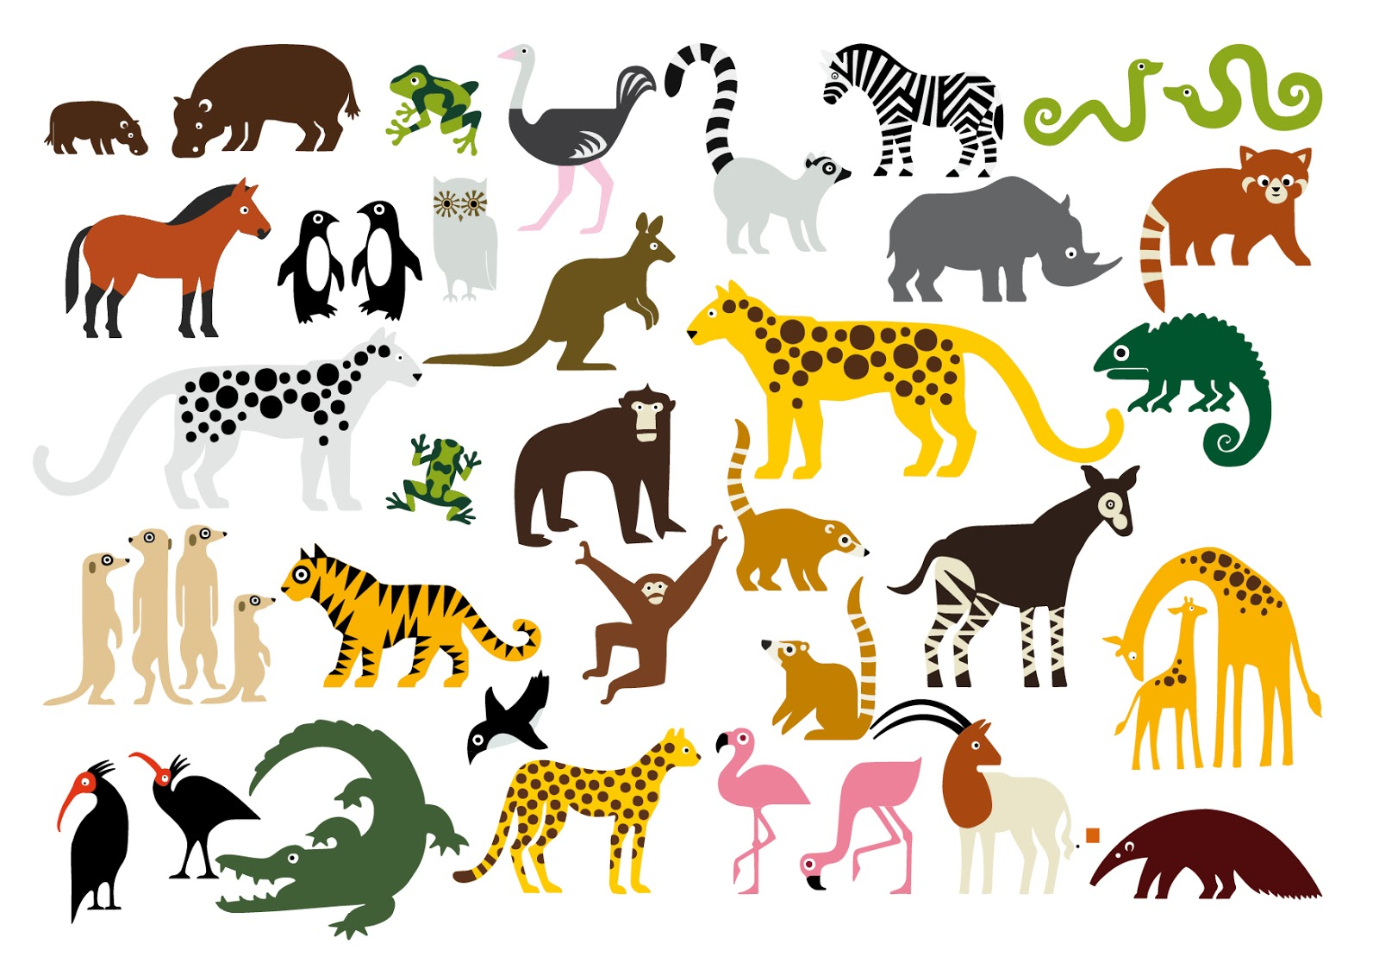
動物〇×クイズ 「できるかな？」
True or False?

Slide 2
I’m a fish. I can swim.

Slide 3
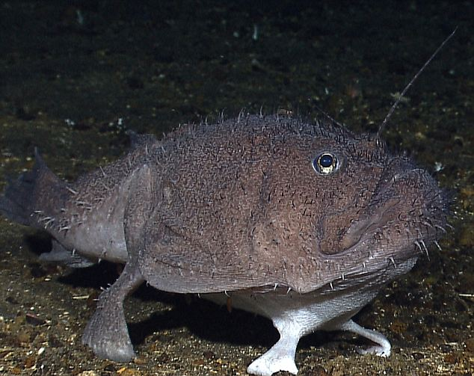
I’m a fish. I can walk.
'Four-legged' fish (An angler fish)

Slide 4
I’m a penguin. I can jump.

Slide 5
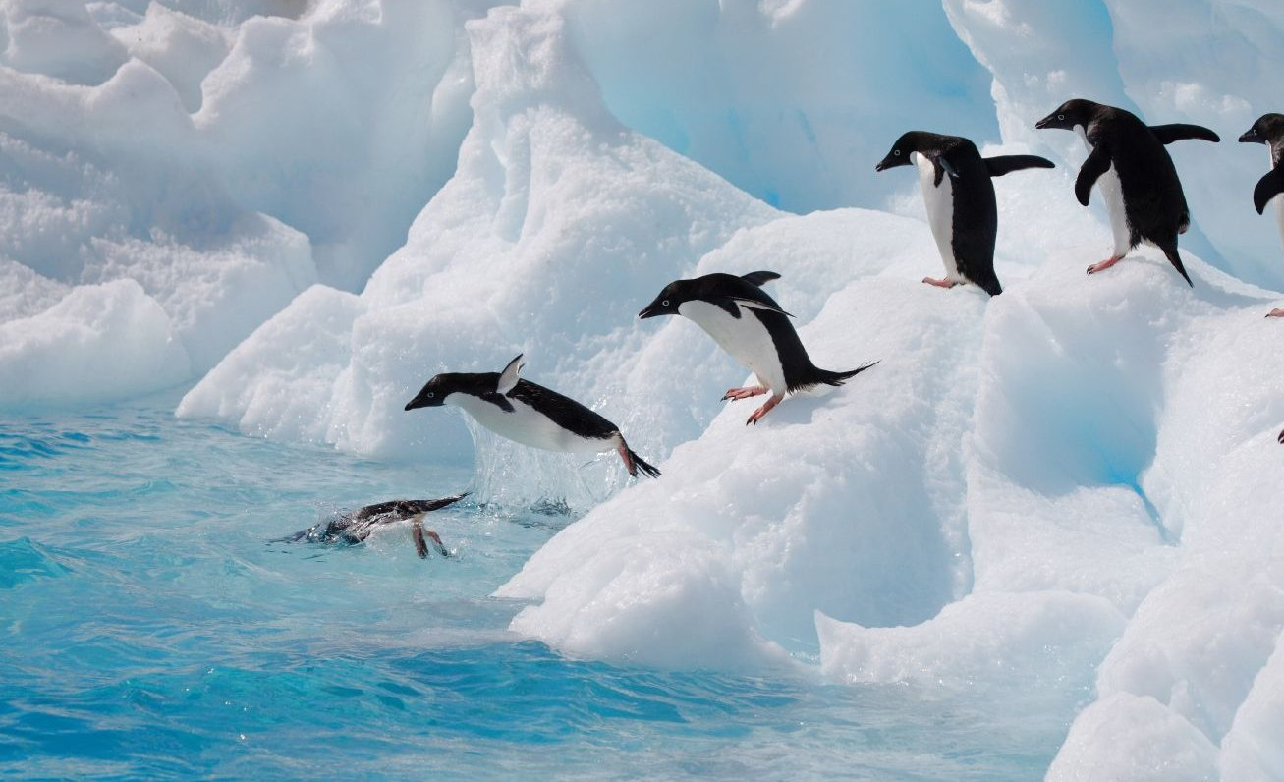
I’m a penguin. I can fly.

Slide 6
I’m a monkey. I can jump.

Slide 7
I’m a monkey. I can swim.

Slide 8
I’m a zebra. I can swim.

Slide 9
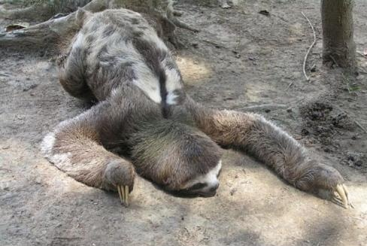
I’m a sloth. I can run.
最高時速0.288 km＊（最高時速 ０．２８８Km

Slide 10
I’m a sloth. I can swim.

Slide 11
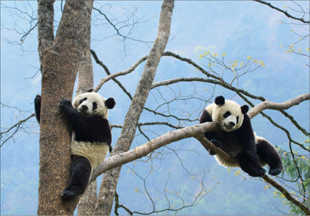
I’m a panda. I can climb a tree.

Slide 12
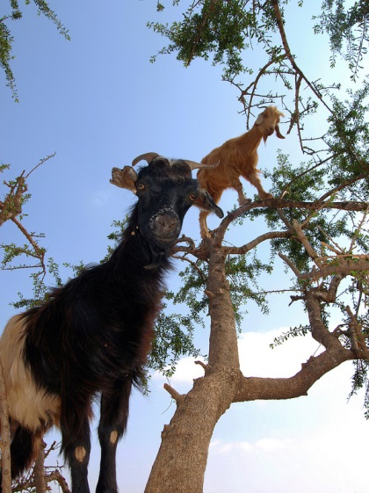
I’m a goat. I can climb a tree.

Slide 13
I’m an elephant. I can swim.

Slide 14
We’re elephants. We can play soccer.

Slide 15
I’m tired!

Slide 16
I’m an elephant. I can dance.

Slide 17
We’re elephants. We can dance.

Slide 18
I’m an elephant. I can draw pictures.

Slide 19
Look at these!

Slide 20
What can you do?
1)

