Slide 1
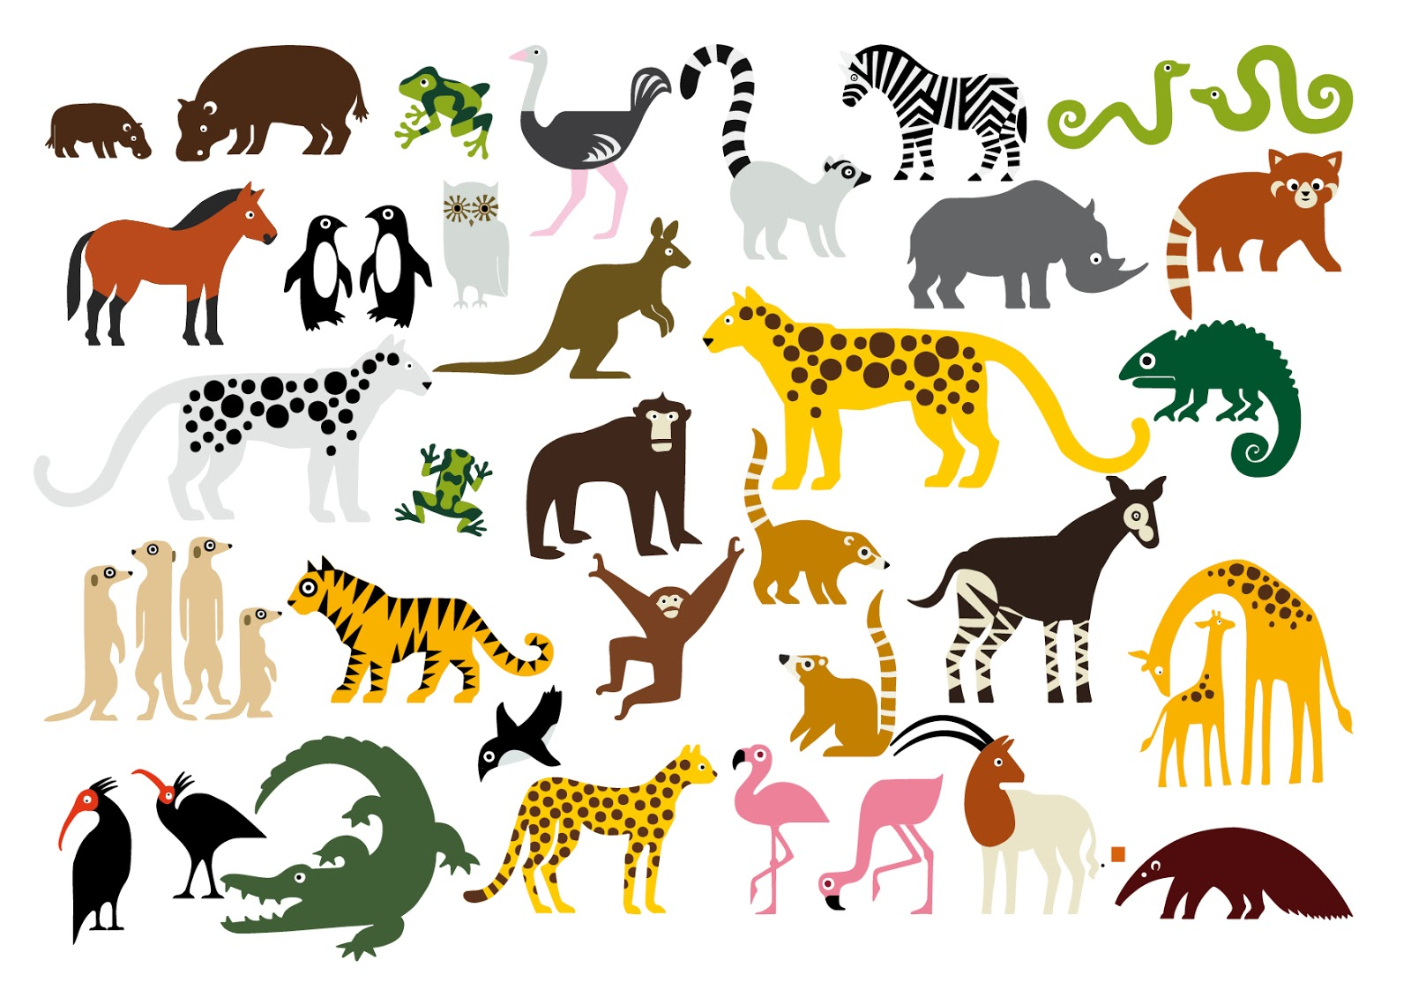
Yes, I can!

Slide 2
I’m a fish. I can swim.

Slide 3
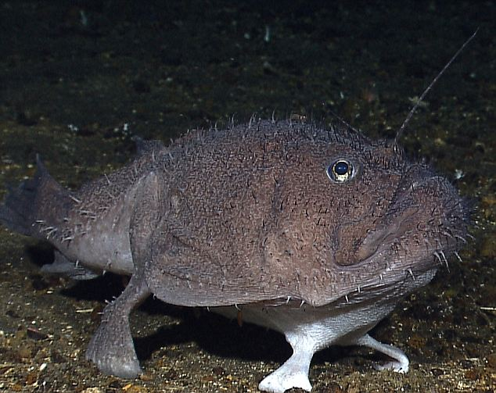
I’m a fish. I can walk.
'Four-legged' fish (An angler fish)

Slide 4
I’m a penguin. I can jump.

Slide 5
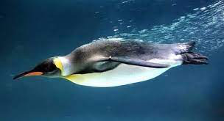
I’m a penguin. I can swim.

Slide 6
I’m a monkey. I can swim.

Slide 7
I’m a zebra. I can swim.

Slide 8
I’m an elephant. I can swim.

Slide 9
We’re elephants. We can play football.

Slide 10
I’m an elephant. I can dance.

Slide 11
I’m an elephant. I can draw pictures.

Slide 12
Look at these!

Slide 13
What can you do?

